Slide 1
Topping the Charts
Using Spotify’s top ten songs to determine the factors of a hit song
Edward Seymour

Slide 2
The Question

Slide 3
There are more musicians now than there were at any point in history. This can be attributed to things like youtube, soundcloud, and the lessening prices of recording equipment. Record labels looking to sign new artists to expensive contracts need to know whether that artist is going to be worth the investment. Spotify's top ten tracks provide an excellent way to investigate the factors that make a song top the charts. I will use the top ten tracks from Spotify throughout the 2010s to determine the qualities of chart topping songs to guide record labels in deciding which artists will be the most successful based on the attributes of their music. I hypothesis that music that is happier and is easier to dance to will be the music that is most successful.

Slide 4
The Data

Slide 5
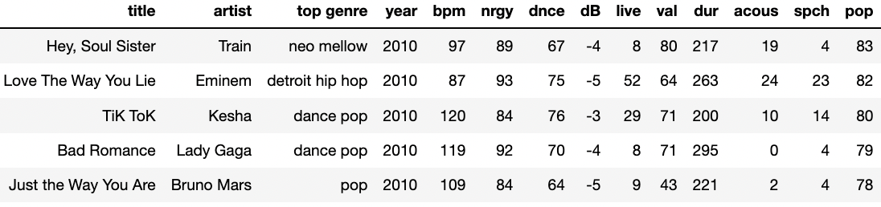
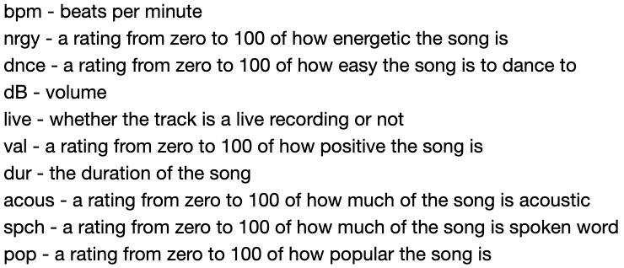
Dataset obtained from Kaggle
Over 600 songs from the 2010s
Important features describing the qualities of the song

Slide 6
The Relationships

Slide 7
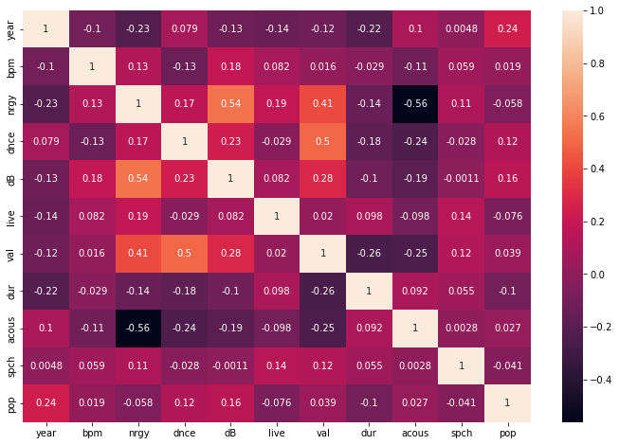
Correlations
Energy and Positivity
Volume and positivity
Acoustic sections negatively correlated to energy
Danceability and positivity

Slide 8
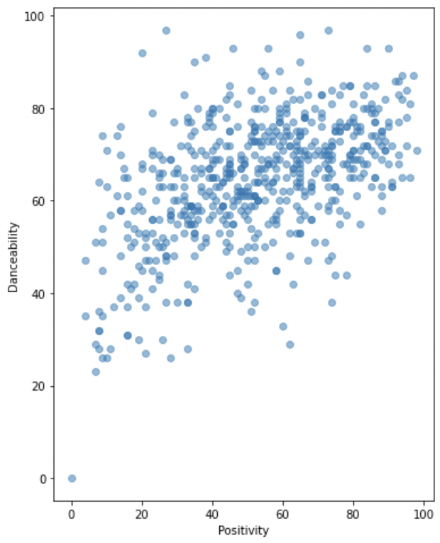
Positive songs are more danceable.

Slide 9
The Trends

Slide 10
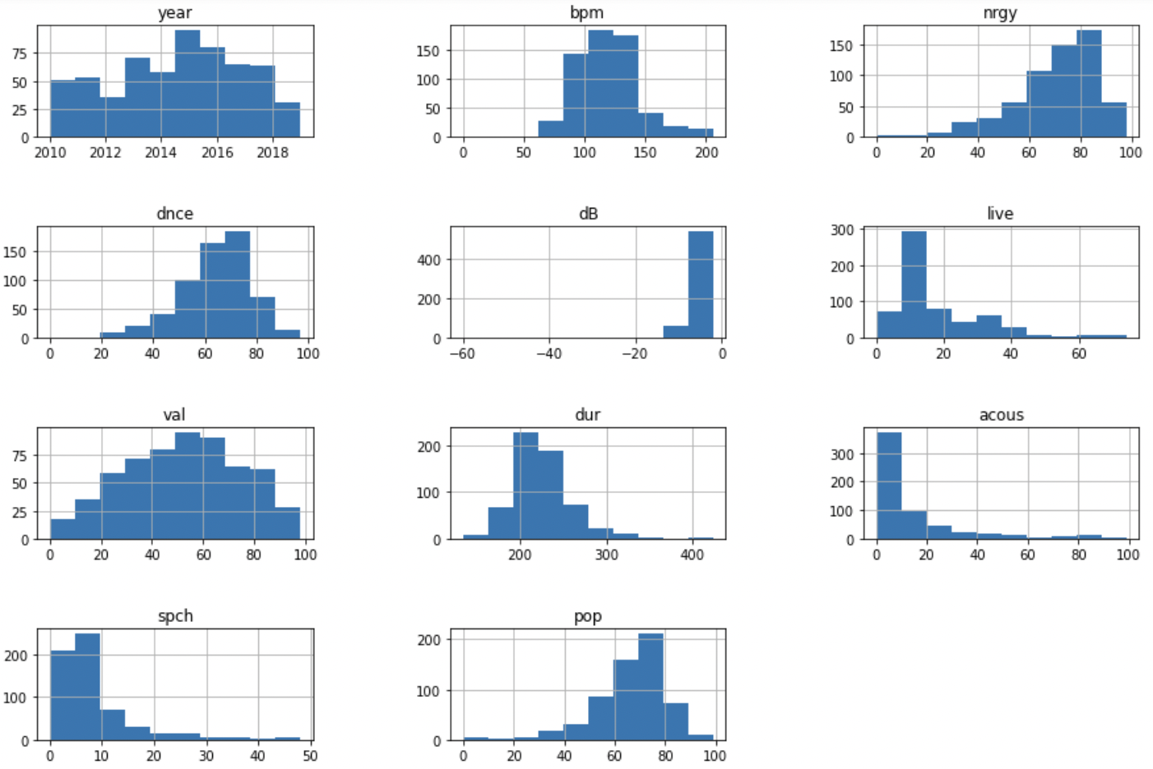
Distributions of song qualities
Low acoustic presence
High energy
Low spoken word ratio
Very danceable

Slide 11
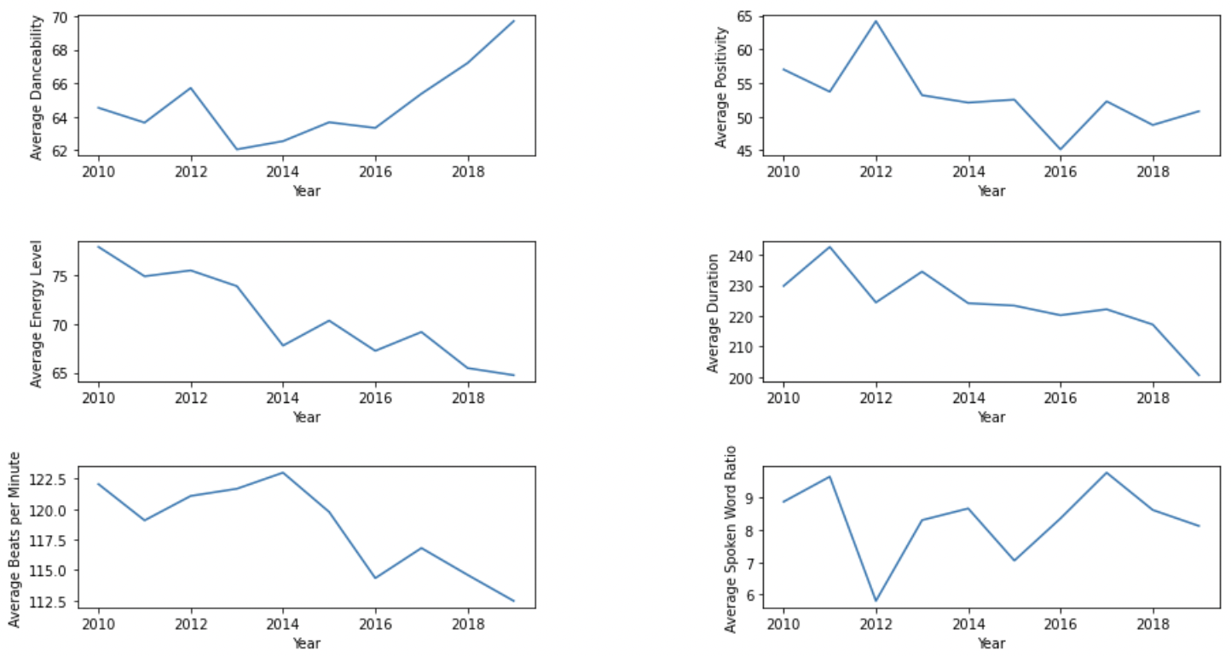
Feature Averages
BPM is down
Danceability is up
Duration is below four minutes

Slide 12
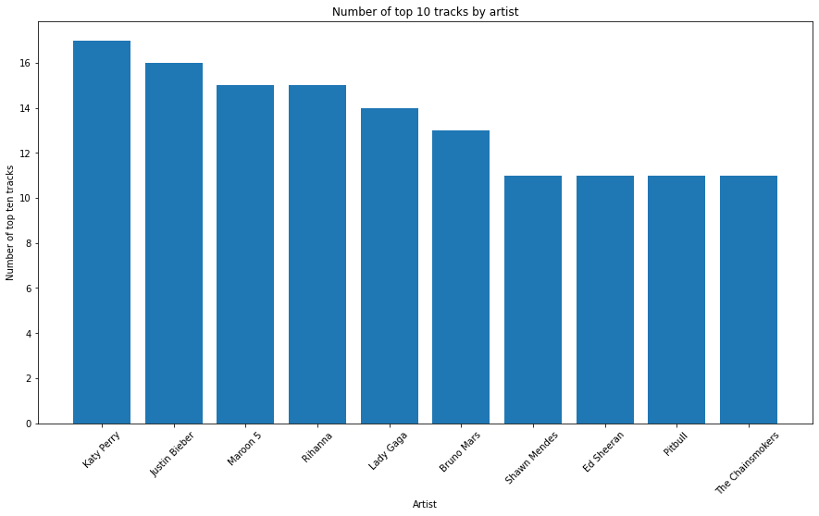
Top Artists
Pop artists win out

Slide 13
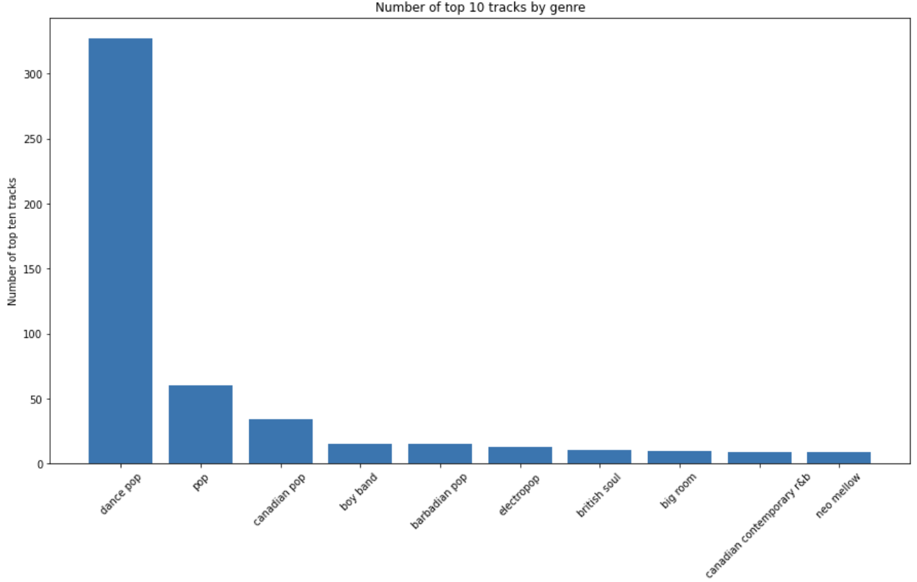
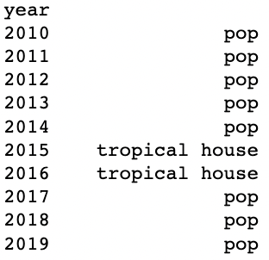
Top Genres
Pop music is consistently the winner

Slide 14
The Conclusion

Slide 15
From the exploration of this data we have gained an understanding of what genres do best on Spotify, pop and its many variations. We've also identified artists that are consistently on top and what genres they are most likely to put out; Katy Perry, Justin Bieber, and Maroon 5 are all pop artists. We looked at how bpm, energy, and positivity are all important factors. Going back to the hypothesis at the beginning, we are correct in our assumption that danceability and positivity needed to be high in order to be a top ten. Record labels will be most successful signing pop artists who put out danceable, positive tracks.

